Slide 1
Lessoning Loosestrife: Using Beetles to Control
Purple Loosestrife
Liz Duff
Education Coordinator - Salt Marsh Science Project
Mass Audubon
&
Beth Suedmeyer
Restoration Planner
Wetlands Restoration Program
MA CZM

Slide 2
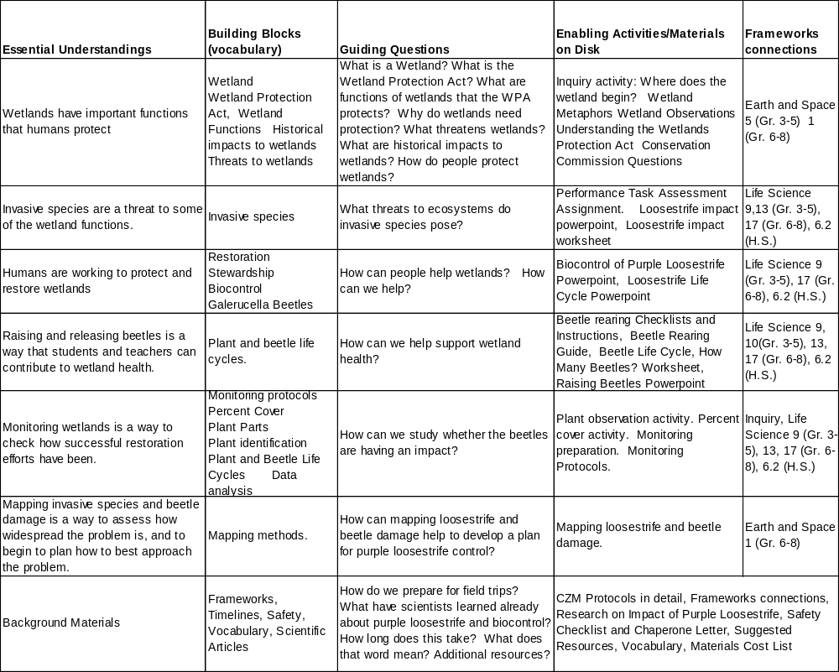
Lessoning Loosestrife Outline

Slide 3
MA Educational Framework Connections
Frameworks connections | Grades 3-5 | Grades 6-8 | High School
Earth and Space | 5. Recognize and discuss the different properties of soil, including color, texture (size of particles), the ability to retain water, and the ability to support the growth of plants. | 1. Recognize, interpret, and be able to create models of the earth’s common physical features in various mapping representations, including contour maps.
Life Science | 13. Give examples of ways in which organisms interact and have different functions within an ecosystem that enable the ecosystem to survive. | Living things and their environment: 13. Give examples of ways in which organisms interact and have different functions within an ecosystem that enable the ecosystem to survive. | Central Concept: Ecology is the interaction among organisms and between organisms and their environment.
Life Science | 7. Give examples of how changes in the environment (drought, cold) have caused some plants and animals to die or move to new locations (migration). | Changes in Ecosystems Over Time: 17 Identify ways in which ecosystems have changed throughout geologic time in response to physical conditions, interactions among organisms, and the actions of humans. Describe how changes may be catastrophes such as volccanic eruptions or ice storms. | 6.2 Analyze changes in population size and biodiversity (speciation and extinction) that result from the following: natural causes, changes in climate, human activity, and the introduction of invasive, non-native species.
Life Science | 9. Recognize plant behaviors, such as the way seedlings’ stems grow toward light and their roots grow downward in response to gravity. Recognize that many plants and animals can survive harsh environments because of seasonal behaviors, e.g., in winter, some animals hibernate, and other animals migrate.
Life Science | 10. Give examples of how organisms can cause changes in their environment to ensure survival. Explain how some of these changes may affect the ecosystem

Slide 4
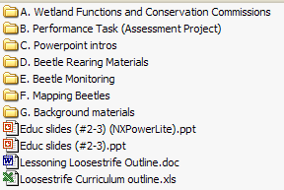
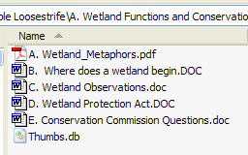
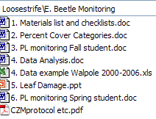
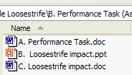


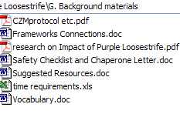
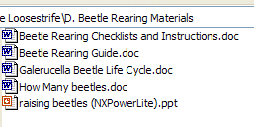
Lessoning Loosestrife
A
E
B
F
C
G
D

Slide 5
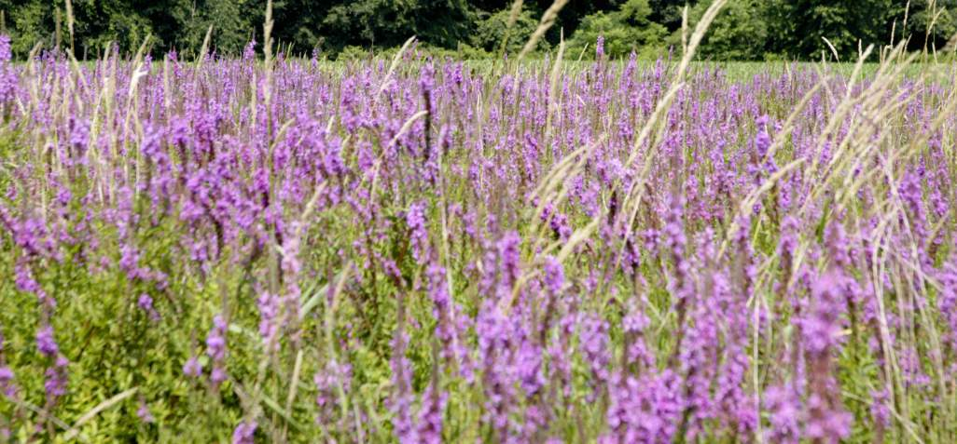
Pretty Purple Plague
Invasive Species Defined ~
Organisms not native to our region and its introduction is harmful to the environment, our health and/or our economy
Notes:
Purple loosestrife is an invasive species this means that it is not native to our region or the US and its introduction is harmful to the environment, our health and/or our economy. Purple loosestrife is native to europe and asia, but there it doesn’t tend to dominate the landscape like it does here…where it takes over our wetlands and shores of lakes ponds and waterways.

Slide 6
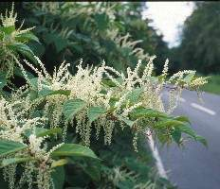
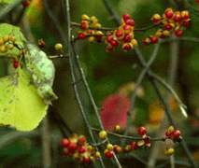
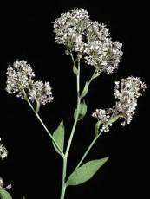
The Invasive Species Threat
In their native environment species are kept in check by natural controls, like predators and food supply. They are part of a balanced system.
When a species is introduced into a new landscape, and it is able to survive and establish itself, the consequences for the environment can be devastating.
Japanese knotweed
Oriental bittersweet
Perennial pepperweed
Notes:
Purple loosestrife is an invasive species this means that it is not native to our region or he US and its introduction is harmful to the environment, our health and/or our economy

Slide 7
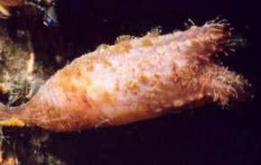
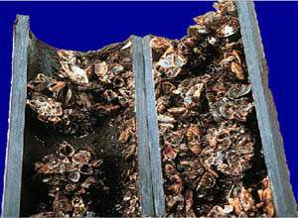
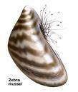
Consequences
Invasive species globally are the second greatest threat to biodiversity
  Have contributed directly to the decline of 42% of the threatened and endangered species in the United States.
The annual cost to the US economy is estimated at $120 billion a year
Source- The Nature Conservancy
Examples of invasive aquatic invertebrates
Club tunicate
Zebra mussels

Slide 8
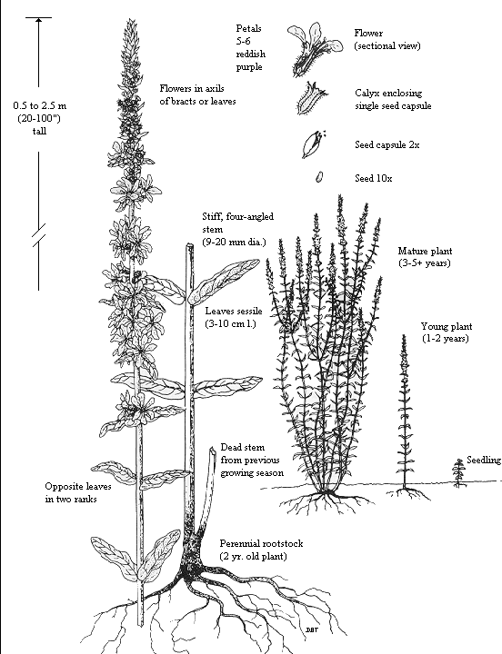
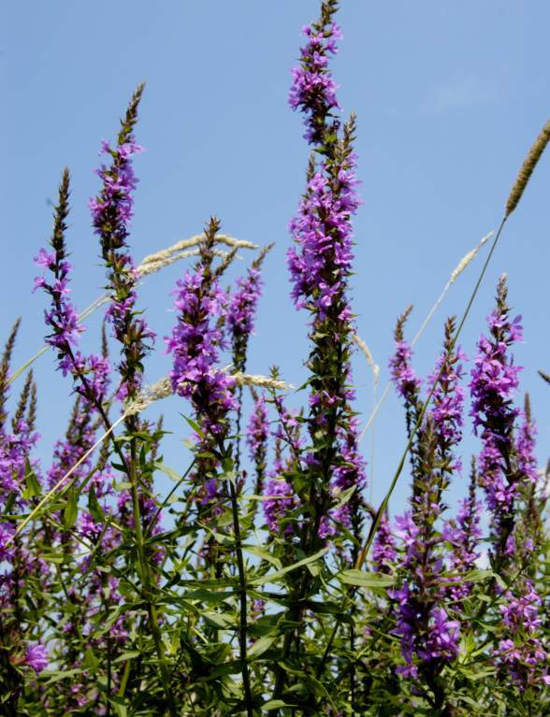
It’s here…
Add some of most fascinating abilities of pL
Original Pathways of introduction
Early 1800s, introduction via ship ballast and raw wool
Horticultural, honey production, and herbal uses
Means of distribution
Wind and water
Wildlife
Human movements (Canals, Highways) and Disturbance
Source: Thompson, Daniel Q., Ronald L. Stuckey, Edith B. Thompson. 1987. Spread, Impact, and Control of Purple Loosestrife (Lythrum salicaria) in North American Wetlands. U.S. Fish and Wildlife Service. 55 pages.
Notes:
Native to Europe and Asia, introduced to US in early 1800s
Found in wetlands, along rivers, in roadside ditches—any semi-wet habitat
Reproduces vegetatively and by seeds
one plant can produce millions of seeds
seeds can remain viable in soil for many years,
roots creating a dense web which chokes out other plant life.

Slide 9
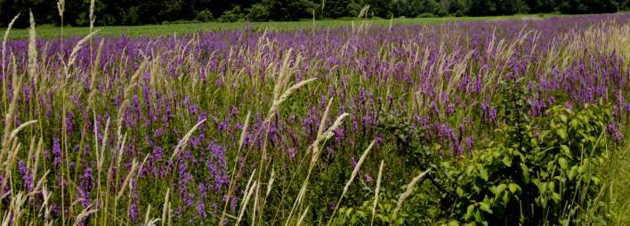
Ecological Impacts of Purple Loosestrife
Reduction in plant biodiversity
Degradation of wildlife habitat
Alteration of wetland function
Blossey, B., L. C. Skinner, and J. Taylor. 2001. Impact and management of Purple loosestrife (Lythrum salicaria) in North America.
Biodiversity and Conservation.
Notes:
Not much research identify the later 2 types of impacts.

Slide 10
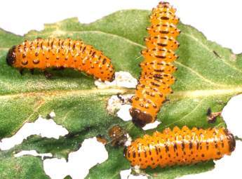
A unique solution—biological control!
Specific to target and self-perpetuating
Long-term control of purple loosestrife (but not eradication)
Requires lower inputs (but possibly longer to realize effects)
Biological control
(biocontrol) defined~
The use of natural enemies to reduce the damage caused by a pest population, such as an invasive plant.
Ultimate goal: Restore wetland habitat and function; give native species a competitive chance.
Notes:
Touch on other control optoins
Herbicides, manual removal/cutting

Slide 11
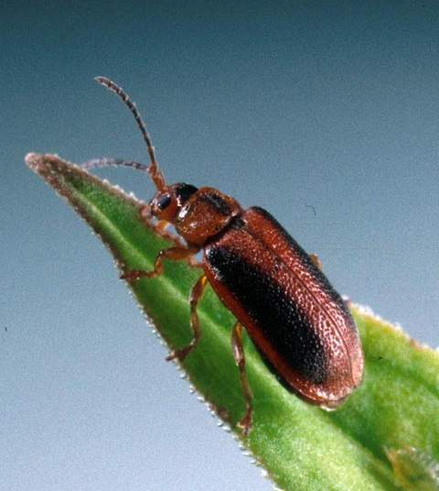
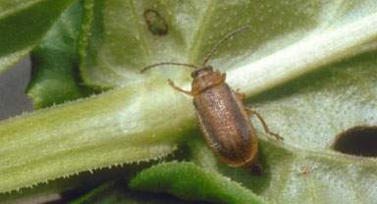
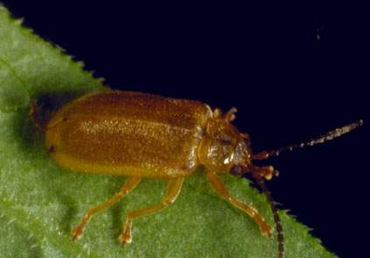
Meet the Beetles
Galerucella species

Slide 12
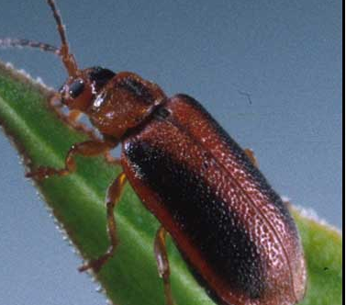
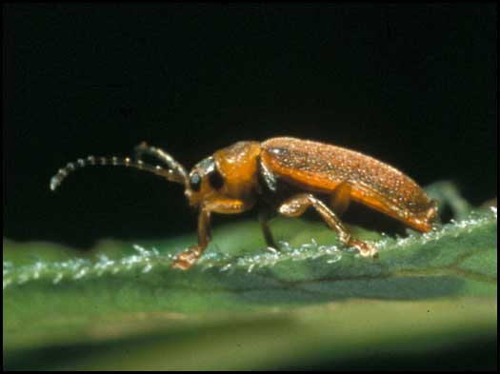
Is this safe?
USDA regulates the use of biocontrol organisms.
Leaf-eating beetles, Galerucella calmariensis and G. pusilla, were approved for U.S. release in 1992 following a lengthy process that determined host-specificity (no negative impacts to other plants) and effectiveness of control.
Research was conducted, primarily at Cornell University, and included:
  Quarantine
  No-choice tests (in lab)
  Initially tested on small scale field plots in the US,
  Then long term monitoring of beetles was evaluated for establishment, spread, impact on the target species, and impact on nontarget species.
Study references for host specificity…
Kaufman L.N.; Landis D.A. (2000) Host Specificity Testing of Galerucella calmariensis L. on Wild and Ornamental Plant Species. Biological Control, Volume 18, Number 2, pp. 157-164(8).
Blossey, B., Schroeder, D., Hight, S.D., and Malecki, R.A. (1994) Host specificity and environmental impact of two leaf beetles (Galerucella calmariensis and G. pusilla) for biological control of purple loosestrife (Lythrum salicaria). Weed Sci., 42: 134-140.
Kok, L.T., McAvoy, T.J., Malecki, R.A., Hight, S.D., Drea, J.J., and Coulson, J.R. (1992) Host specificity tests of Galerucella calmariensis (L.) and G. pusilla(Duft.), potential biological control agents of purple loosestrife, Lythrum salicaria L. Bio. Control, 2: 282-290.
Malecki, R.A., Blossey, B., Hight, S.D., Schroeder, D., Kok, L.T., and Coulson, J.R. (1993) Biological control of purple loosestrife: a case for using insects as control agents, after rigorous screening, and for integrating release strategies with research. BioSci., 43: 680-686.
Notes:
No choice tests are when different plants are put in an enclosure (one at a time) with the beetles and it is recorded if the beetles feed on that plant.
Study references for host specificity…
Kaufman L.N.; Landis D.A. Host Specificity Testing of Galerucella calmariensis L. on Wild and Ornamental Plant Species. Biological Control, Volume 18, Number 2, June 2000 , pp. 157-164(8)
Blossey, B., Schroeder, D., Hight, S.D., and Malecki, R.A. (1994) Host specificity and environmental impact of two leaf beetles (Galerucella calmariensis and G. pusilla) for biological control of purple loosestrife (Lythrum salicaria). Weed Sci., 42: 134-140.
Kok, L.T., McAvoy, T.J., Malecki, R.A., Hight, S.D., Drea, J.J., and Coulson, J.R. (1992) Host specificity tests of Galerucella calmariensis (L.) and G. pusilla(Duft.) (Coleoptera: Chrysomelidae), potential biological control agents of purple loosestrife, Lythrum salicaria L. (Lythraceae), Bio. Control, 2: 282-290.
Malecki, R.A., Blossey, B., Hight, S.D., Schroeder, D., Kok, L.T., and Coulson, J.R. (1993) Biological control of purple loosestrife: a case for using insects as control agents, after rigorous screening, and for integrating release strategies with research. BioSci., 43: 680-686.

Slide 13
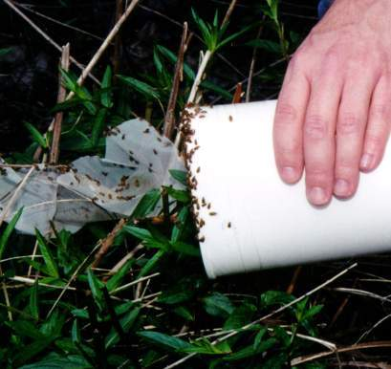
History in MA
Released at two national wildlife refuges (Parker River and Great Meadows) began releasing Galerucella beetles in1996/98.
MA Wetland Restoration Program (WRP) coordinated first release in 2000 at a Walpole site.
Since then WRP has coordinated releases at 26 other sites.
Total beetles released since 2000—approximately 300,000.

Slide 14
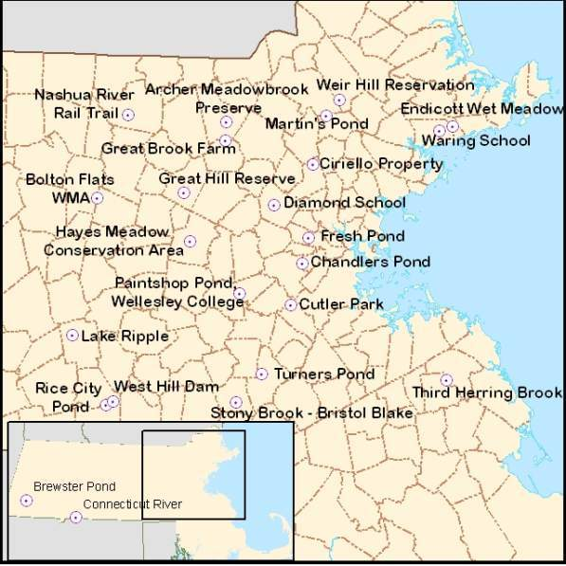
WRP Purple Loosestrife Biocontrol Sites

Slide 15
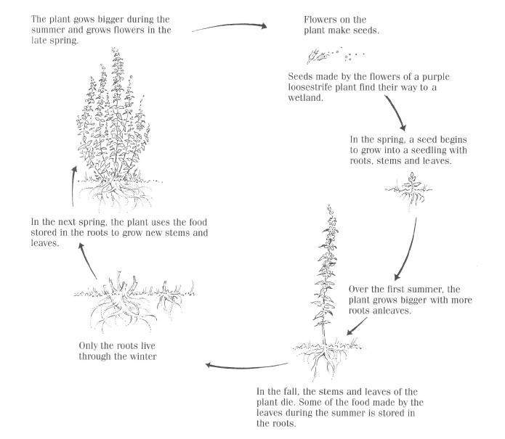
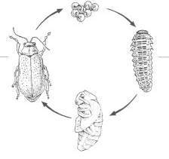
What’s happening in the wetland
The plant grows bigger during the summer and grows flowers at the end of the summer.
JUNE
egg clusters deposited on stem and leaves
MAY
Emerge to feed and mate
AUG
Second generation emerges
WINTER
as adults dormant in soil
First 2 years of purple loosestrife growth
JULY
Larva feeding on leaves
JULY- AUG
Pupa in soil
Diagram from MSU Purple Loosestrife Project – Upper Elementary Lessons Student Workbook.

Slide 16
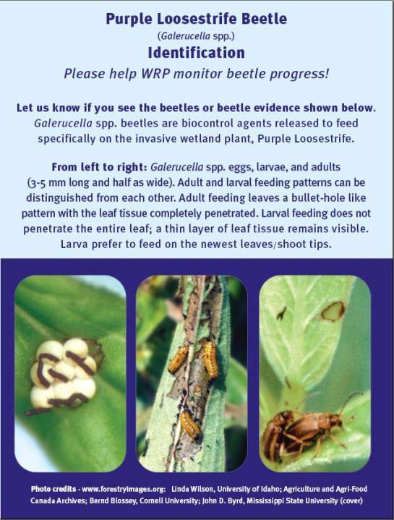
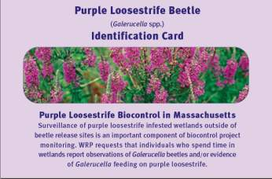

New Mapping initiative
Examine Purple Loosestrife Stands and report observations (beetle presence and damage).

Slide 17
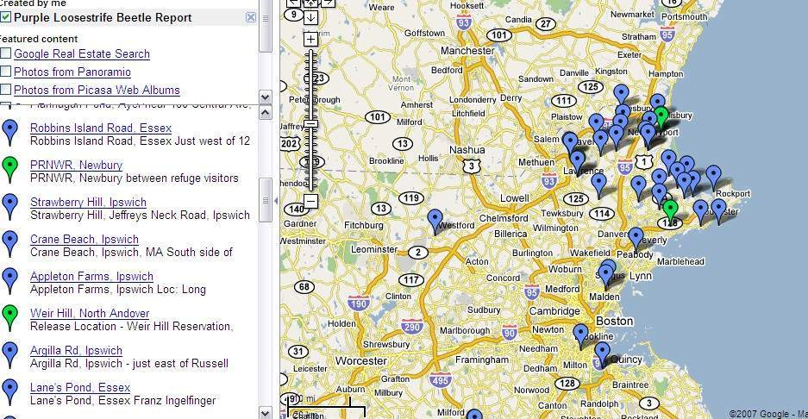
Reporting Observations via Google Maps
You can add your
observations to the map!
Beetles have dispersed as far as 10 miles from release sites.

Slide 18
Monitoring
Standard methodology used across the U.S.
Monitoring plots are 1x1 m quadrats, marked with wood stakes or PVC pipe.
Monitor twice each year for at least three years.
Document changes at site (and of each plot) with photos
10m
Release plot
Photo reference point

Slide 19
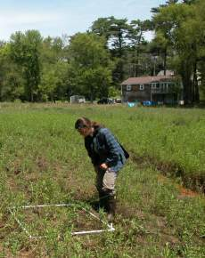
Monitoring methods
Spring Monitoring includes:
Visual assessment of the abundance of Galerucella eggs, larvae, and adults,
Estimation of damage to purple loosestrife plants,
Estimation of percent cover and count of stems of loosestrife and cattails.
Fall Monitoring includes:
Estimation of percent cover and count of stems of loosestrife and cattails.
Height of five tallest loosestrife and Cattails stems,
Measurements of infloresences and flowers.
Qualitative and quantitative observations of other insect and plant species.

Slide 20
Why monitor?
Looking at the data over time helps us to see if there are any trends -- Are the purple loosestrife plants responding to the introduction of the beetles?
Hypothesis: Purple loosestrife will be reduced by the introduction of the Galerucella beetles.
Does the field collected data support this hypothesis?
The data collected allows us to look at this reduction in more than one way.
Are there changes in Purple Loosestrife’s-
  Stem height?
  Space that it is taking up (percent cover)?
  Seed production?
We also expect to see changes in other plants growing alongside the purple loosestrife.

Slide 21
HANDS ON
Demonstration of Monitoring Methods

Slide 22
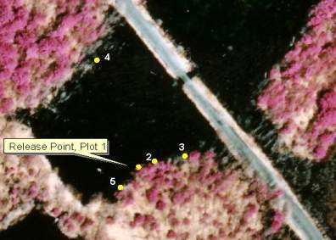
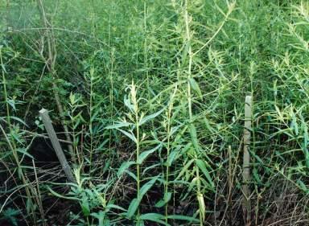
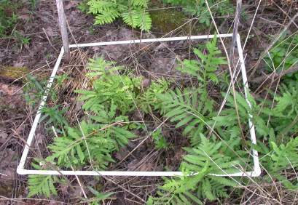
Results Walpole Site
Three releases
(1st in 2000, total 30,000 beetles)
Photo documentation of quadrats
Quadrat #2, 2002
Quadrat #2, 2004

Slide 23
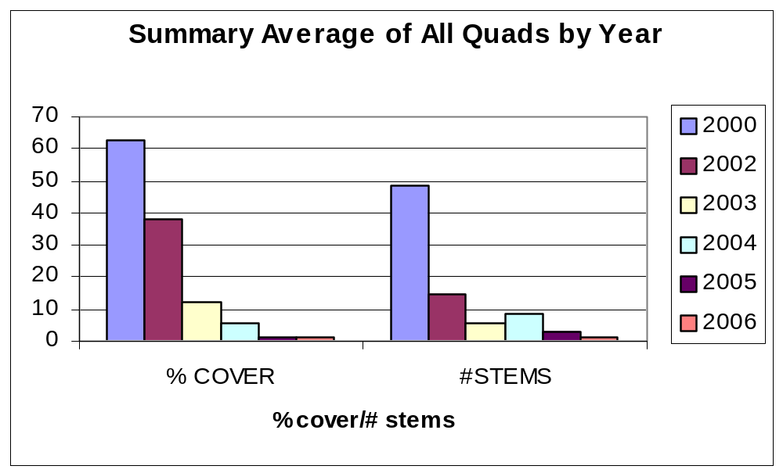
Monitoring Data for Walpole Site
Releases happened in 2000, 2001, 2002. Five plots monitored. No data collected for 2001.

Slide 24
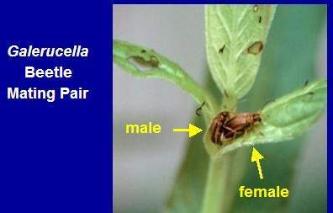
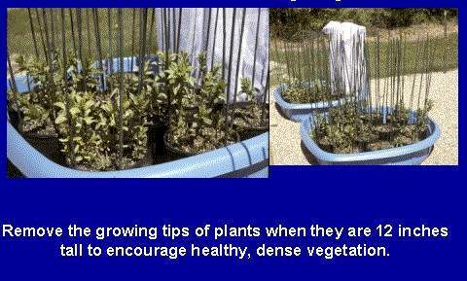
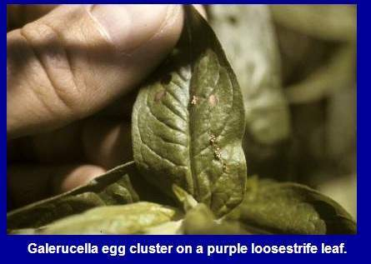
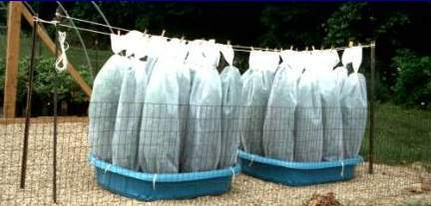
Beetle Rearing

Slide 25
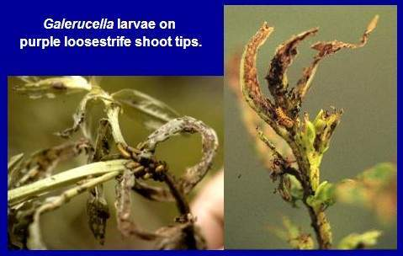
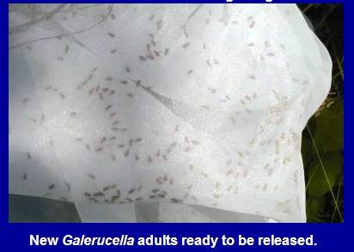
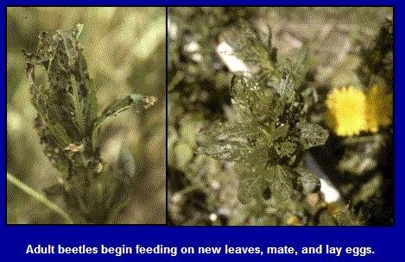
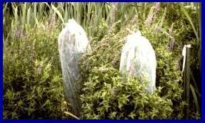
Release and Damage

Slide 26
Acknowledgements
Partners for Fish and Wildlife Program USFWS
Coastal Americas Foundation
Corporate Wetlands Restoration Partnership
EPA 5-star Restoration Program & grant team
Site coordinators and volunteers
Image and slide use
Donna Ellis – CT Beetle Farmer Program
MSU Purple Loosestrife Project

